Slide 1
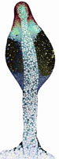
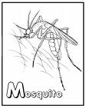
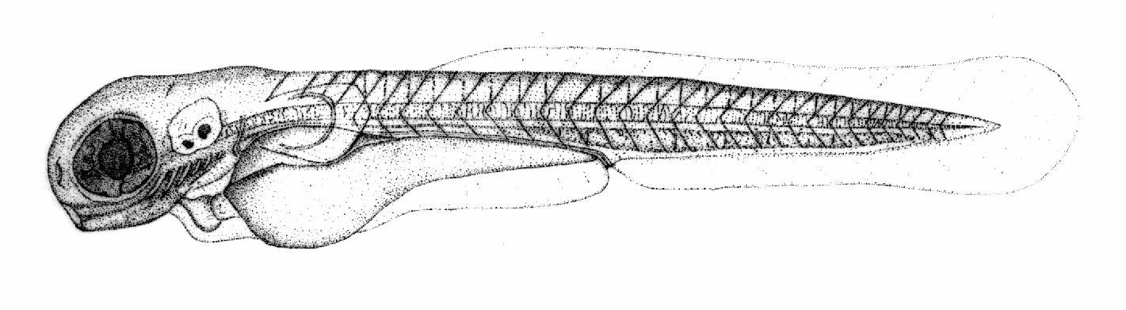
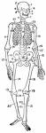
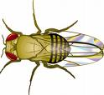



Anatomy Ontology Community
Melissa Haendel

Slide 2
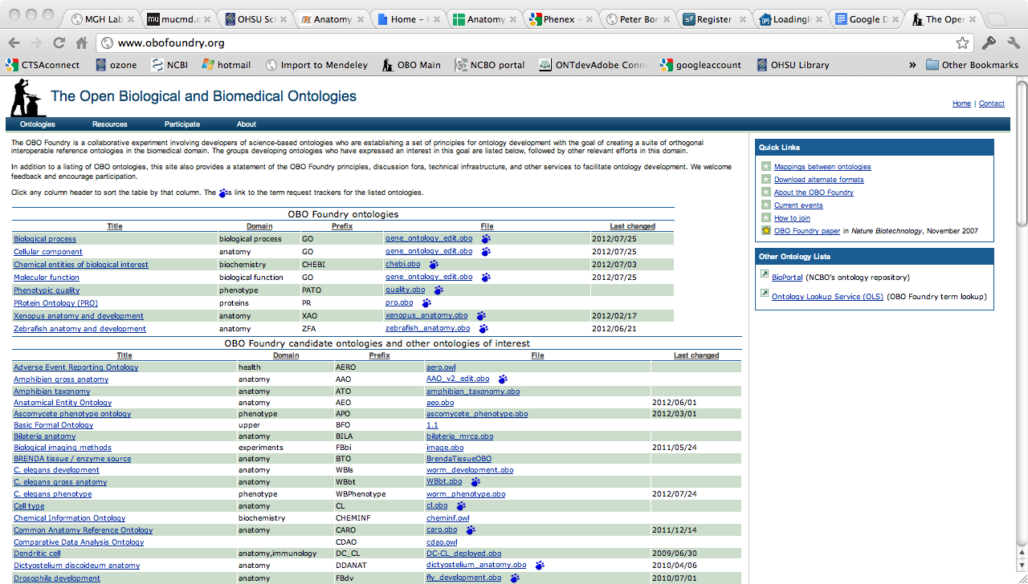
The OBO Foundry
http://www.obofoundry.org/
More than just a website, it’s a community of ontology developers dedicated to working together using common principles

Slide 3
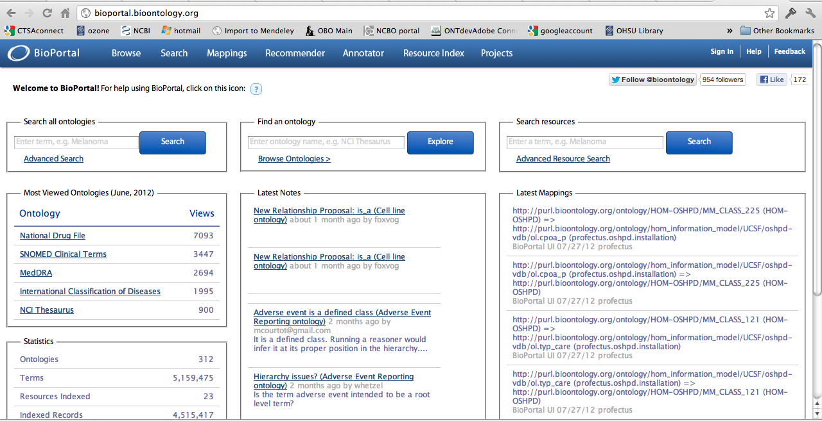
Bioportal
http://bioportal.bioontology.org/
A library of ontologies and ontology related services

Slide 4
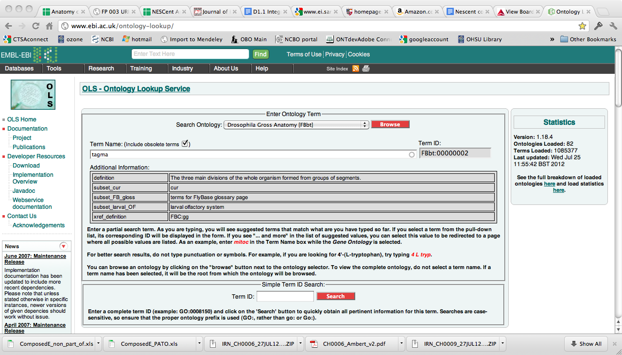
Ontology Lookup Service
http://www.ebi.ac.uk/ontology-lookup/

Slide 5
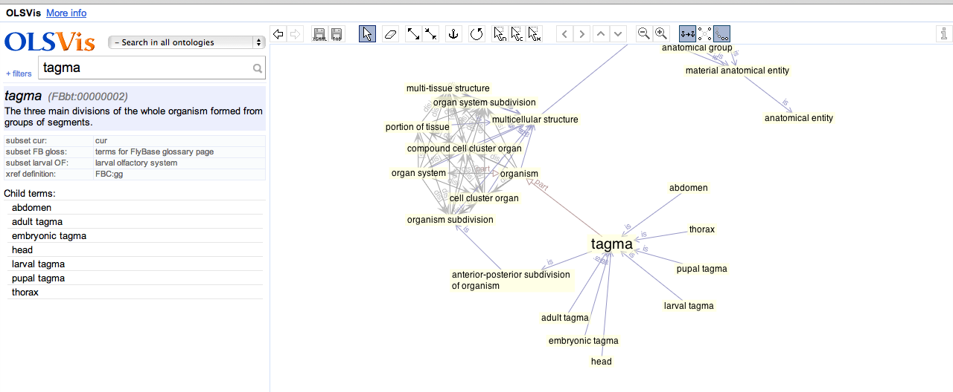
Ontology Lookup Service
Query and visualize OBO ontologies
http://ols.wordvis.com/

Slide 6
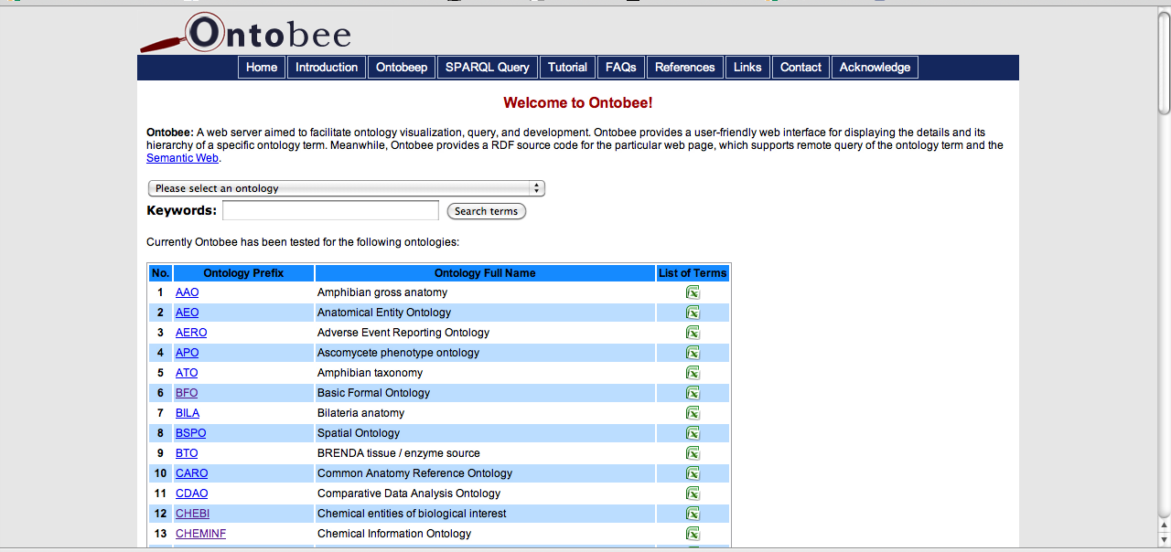
Ontobee
http://www.ontobee.org/
Query OBO ontologies, and provides RDF supporting remote query of each ontology term and the Semantic Web

Slide 7
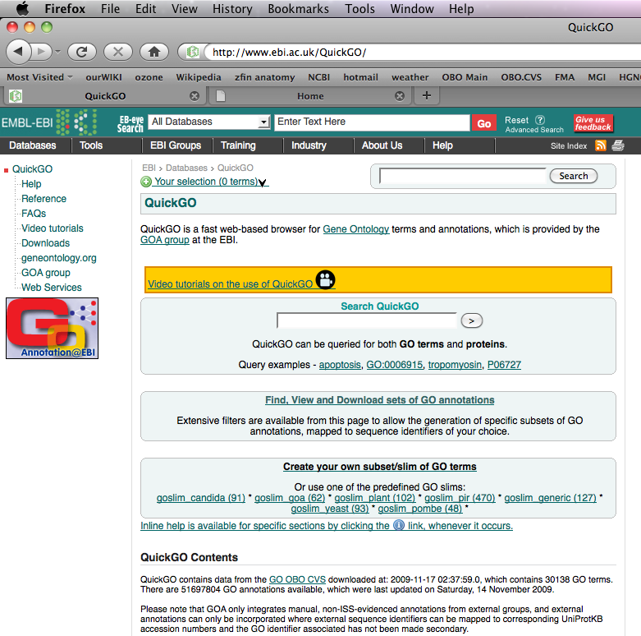
QuickGO at the EBI
http://www.ebi.ac.uk/QuickGO/

Slide 8
OBO Foundry Principles
The purpose? To create a community of standards and collaboration that promote interoperability and quality development practices
FP 001 open
FP 002 format
FP 003 URIs
FP 004 versioning
FP 005 delineated content
FP 006 textual definitions
FP 007 relations
FP 008 documented
FP 009 users
FP 010 collaboration
FP 011 locus of authority
FP 012 naming conventions
FP 013 genus differentia
FP 014 BFO
FP 015 single inheritance
FP 016 maintenance
FP 017 instantiability
FP 018 orthogonality
FP 019 content
http://obofoundry.org/wiki/index.php/Category:Principles

Slide 9
A few good practices
Use numeric URIs so that the meaning is truly in the definition and not the label
Make sure all entities have either text or logical defs, both is best.
Use a unique label for your classes – think about this in the context of the whole world, its ok to have community specific labels in addition to the unique label.
Use Version Control, and release versions
Delineate content and build according to your requirements – don’t attempt to represent all of reality!
Use upper ontologies and design documents to help structure your work
Document, document, document!
Communicate, share, have fun!

Slide 10
OBO Foundry Listserves
The anatomy ontology community has a large number of listeserves to coordinate collaborative efforts. A list of lists is:
http://www.obofoundry.org/cgi-bin/discussion.cgi
The most relevant ones are:
https://lists.sourceforge.net/lists/listinfo/obo-discuss
https://lists.sourceforge.net/lists/listinfo/obo-anatomy
https://lists.sourceforge.net/lists/listinfo/obo-cell-type
https://lists.sourceforge.net/lists/listinfo/obo-phenotype
Note that most of these are fairly low traffic, and these are archived

Slide 11
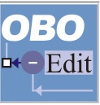

Two ontology editors and their development and user communities
OBOEdit- OBO ontology editor and viewer
http://oboedit.org/
OBO-Edit Working Group
geneontology-oboedit-working-group@lists.sourceforge.net
Bugs should be reported here:
http://sourceforge.net/tracker/?group_id=36855&atid=418257
Protégé - OWL ontology editor and viewer
http://protege.stanford.edu/
Protégé user group:
https://mailman.stanford.edu/mailman/listinfo/protege-owl
Protégé 4.X feedback:
https://mailman.stanford.edu/mailman/listinfo/p4-feedback
Notes:
Do we have this slide in matt’s talk?

Slide 12
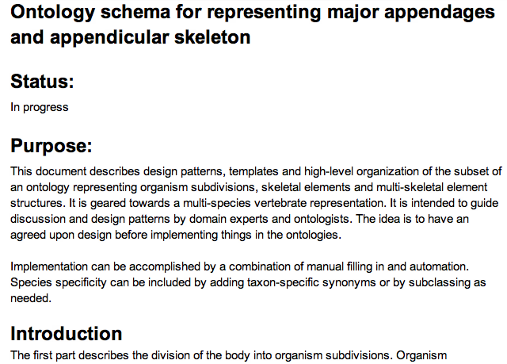
It’s all too easy just to dive in. Design documents help you plan ahead, ensure you are meeting requirements, and collaboratively decide design features.
http://bit.ly/OcMj9f
Example:

Slide 13
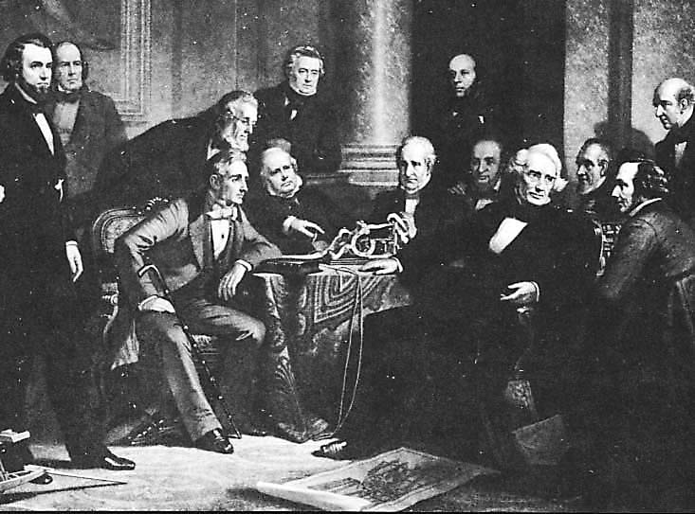
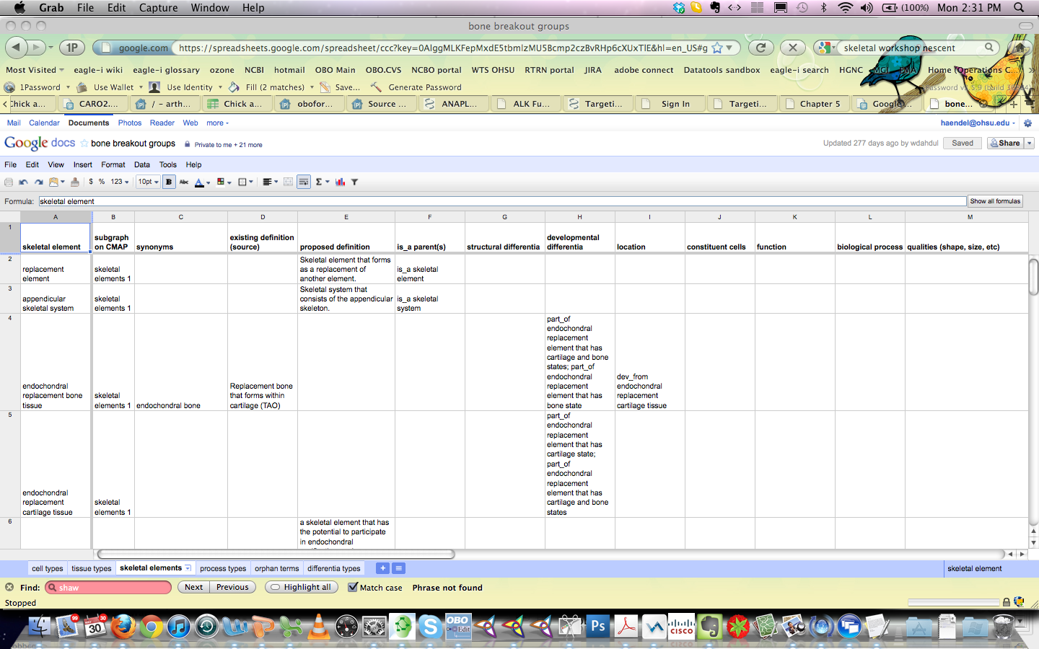
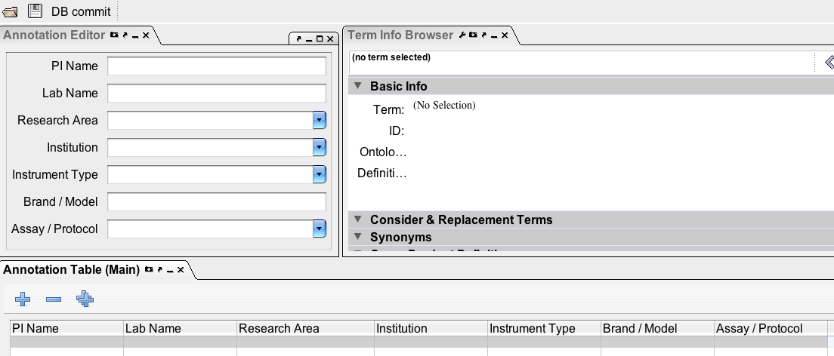
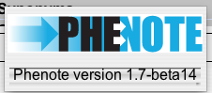
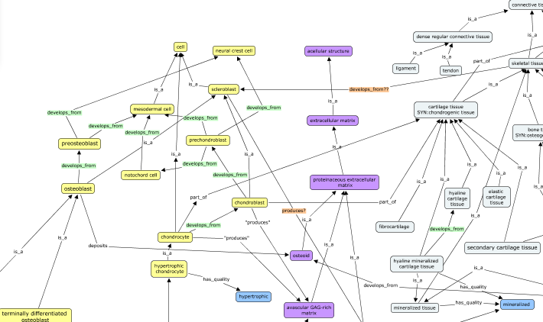
Other mechanisms of extracting knowledge from domain experts
1862 Christian Schussele
Familiar tooling: Google docs, Phenote, Excel
Visualization: Cmap, Vue, GraphViz

Slide 14
What is a tracker?
A tracker is a place to put a formal ontology request.
Trackers have long been used in the software community for keeping track of bugs, feature requests, etc.
In the ontology community, they are quite valuable because they provide a documented, structured requests for changes or additions.
Tracker IDs can be referenced in ontology metadata- such as in an editor note or definition annotation.

Slide 15
How do you write a tracker request?
It is important that when you make a tracker request, you provide as much information as possible, in order to facilitate the change you are requesting and future reference
For new terms, or term rearrangements, provide the intended hierarchy – both SubClass as well as any other relations required (such as partonomy)
Provide text definitions, that make sense in the Genus Differentia context, for all new or edited terms
Provide attribution for the definitions
Some commentary may occur on the tracker item, but can sometimes lead to long listserve discussions before returning to a decision on the tracker
Complex issues requiring decision are best first discussed on the listserves or in design documents, but its always better to say something somewhere!

Slide 16
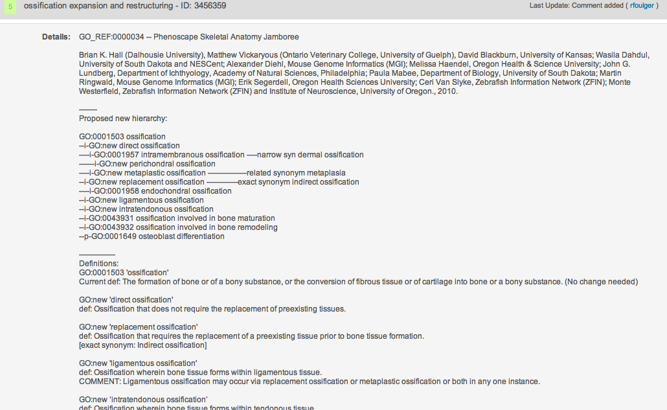
Example tracker request
https://sourceforge.net/tracker/index.php?func=detail&aid=3456359&group_id=36855&atid=440764

Slide 17
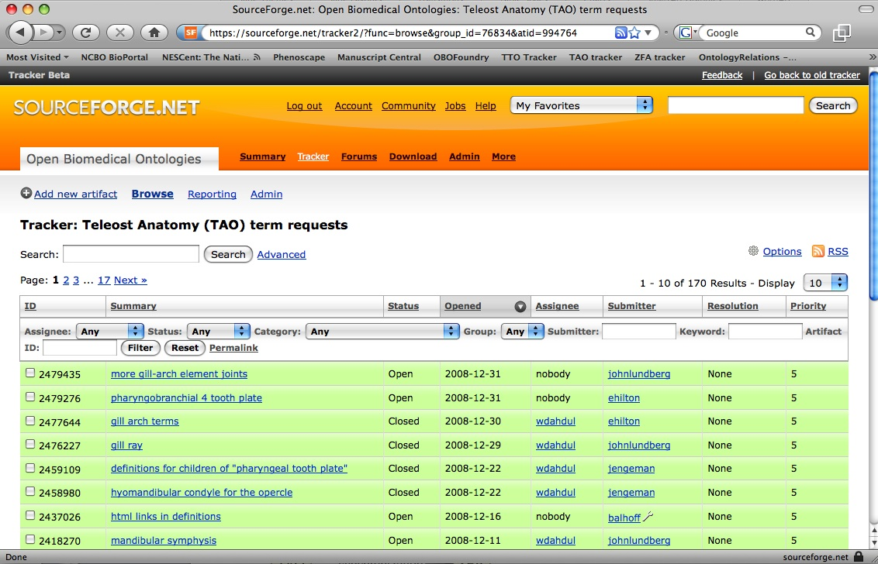
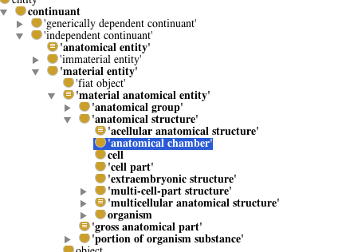
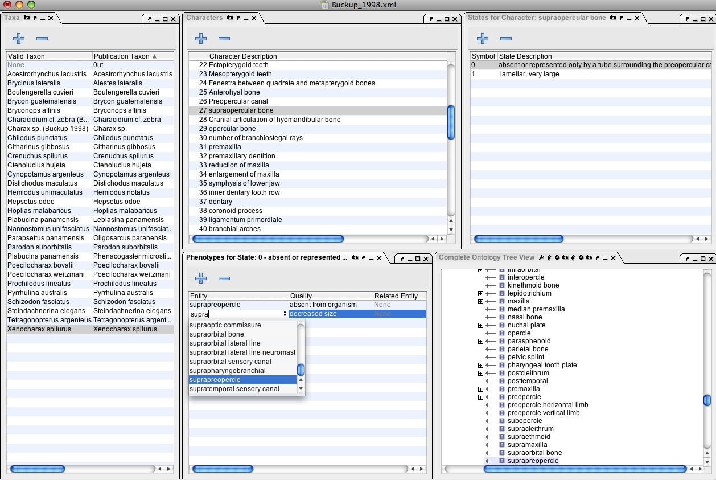
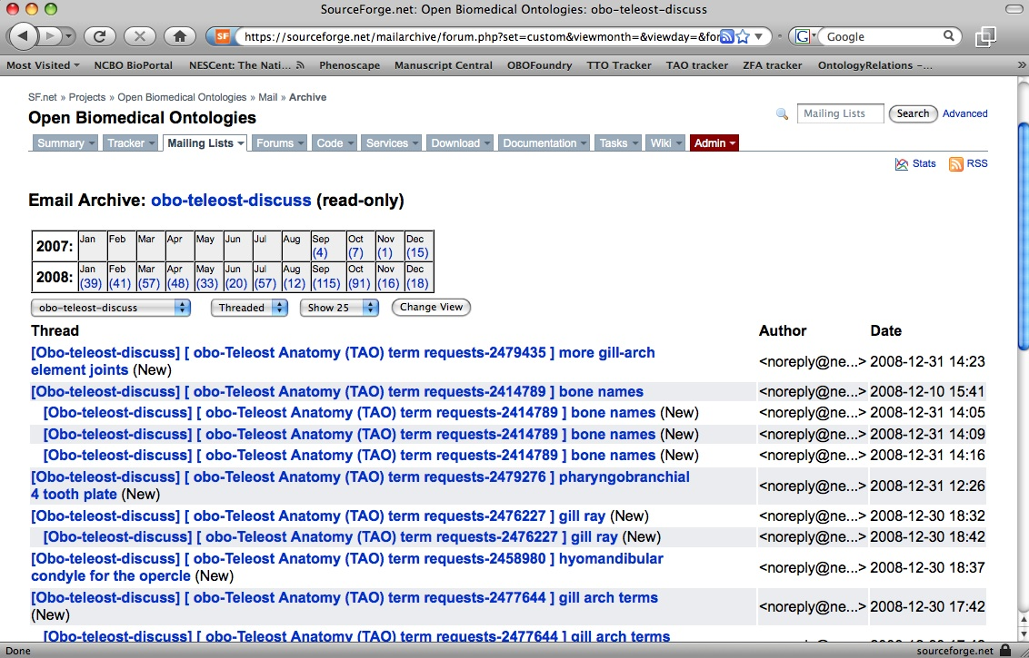
Lists, trackers, ontologies, annotation, oh my!
Ontology Edited
Tracker IDs can be in ontology metadata
Term requested
Trackers are often autoemailed to integrated listserves
Term brokers are being developed to create temp classes during ontology editing or annotation
Design documents comment on existing ontologies
Term discussed by community
Term needed for annotation
Design and requirements analysis
Notes:
Add design documents

Slide 18

Your work affects others
Anatomy ontologies have very overlapping content
We can reuse common design patterns gaining us:
Interoperability
Ease of implementation
Quality reasoning power
Decreased duplicative effort
It is likely nothing you do in an anatomy ontology will remain siloed - eventually it will matter in the greater context
GO
MP
UBERON
CARO
MA
AAO
TAO
XAO
ZFA
CL

Slide 19
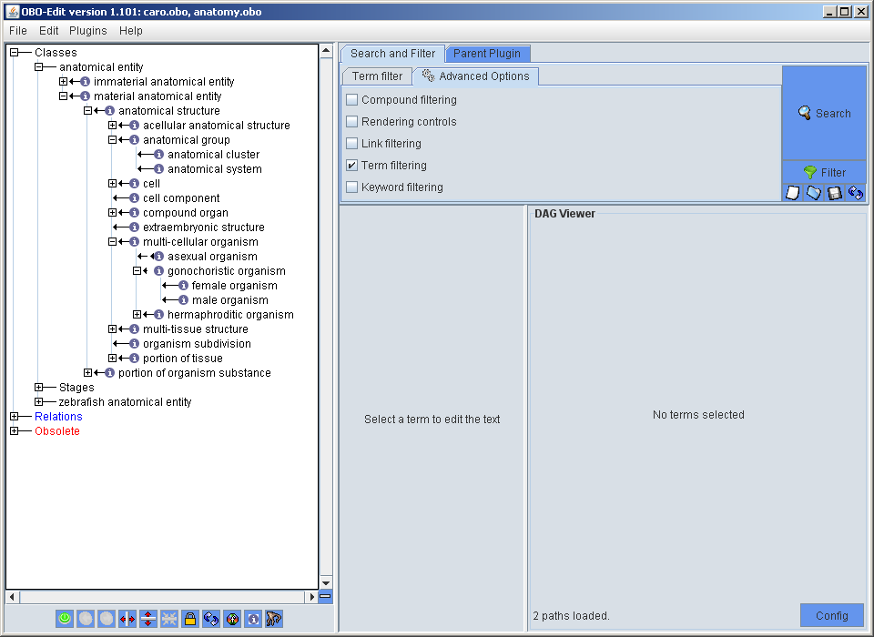
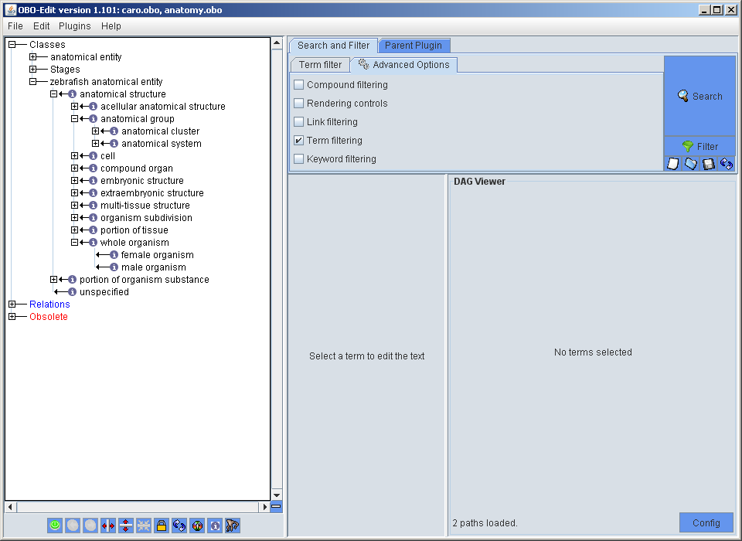
Using CARO as a template
CARO
is_a
zebrafish AO
Zebrafish classes are asserted to be subclasses of CARO classes
Cell and cell component are cross-referenced to GO

Slide 20
Metadata standards
Just like a class or property definition, we all need to use annotation properties in the same way. Note that we are working towards full interoperability between OBO standards and the IAO core metadata ontology. Here are some standards sources.:
OBO Annotation standards
http://www.geneontology.org/GO.format.obo-1_4.shtml#S.1.1
Information Artifact Ontology Core Metadata
http://code.google.com/p/information-artifact-ontology/wiki/OntologyMetadata
W3C standards:
http://www.w3.org/TR/2009/REC-owl2-quick-reference-20091027/#Annotations

Slide 21
Ontology documentation
Where does it happen?
Potentially too many places and at the same time, not enough!
Wikis: a nice public way to describe the overall content. Examples: uberon.org, http://code.google.com/p/eagle-i/wiki/Documentation
Commit messages. Example: https://code.google.com/p/cell-ontology/source/detail?r=44
Releases and release notes. Example: http://obi-ontology.org/page/Releases/2012-07-01
Internal documentation

Slide 22
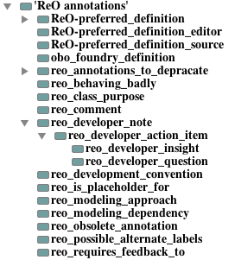
Internal documentation
We have a lot of annotation properties for this: Definitions, Definition source, Comments, Editor Notes, Feedback_to, etc. This is one of the best places to keep documentation of design choices- right in the ontology.
ReO- Reagent ontology- we are experimenting with defining more standard annotation properties. These will eventually go into IAO.
http://reagent-ontology.googlecode.com/svn/trunk/src/ontology/reo.owl
These properties allow query of the ontology – for example, generate term requests from all classes annotated with “requires_feedback_to”

Slide 23
When to obsolete
Why are we discussing this in the communities section?
Because deprecating a class and the reasons for doing so are incredibly important to your community of users
Deprecate = Obsolete ≠ Destroy = Delete
Has your ontology been made available to the public? If yes, consider obsoleting rather than deleting. (Note- keeping your ontology in GoogleCode is public!! Once an ID is out in the wild, it needs to be tracked.)
Has the text or logical definition of the class or property changed substantially? Remember, the ID is attached to the logical/non-logical definition, NOT the label. Changing a label does not require obsolescence.
Is the term confounded and needs to be split or merged into another class? Consider using the replaced_by or consider annotation properties on obsoleted entities to point users to the right new entities
Communicate ontology changes, in particular obsolescence, in release notes and VC commits

Slide 24
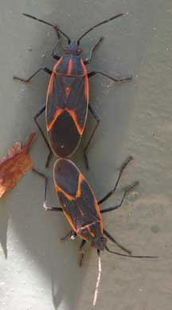
Feeling the love?
http://www.whatsthatbug.com/2008/07/05/mating-boxelder-bugs/
Find a partner.

